Slide 1
Welcome to the Adventurers guild
To Create a full stack web application using the 3 tier architecture system.
•The Application is an Adventureres Guild which Allows users to Create, Read, Update, Delete their Adventurer and Create guilds.

Slide 2
Initial Approach
Trying to Understanding the project
Breaking down the MVP
Failed to have a proper mindset and Goal In mind. ( Early git problems, started without jira board created)
Initial design process –ERD to visualize my ideas
Writing the logical approach to the project down.
Begin the Project

Slide 3
Character Creation
I wanted to add my Personal twist too the character Creation Menu by making it a magic Academy. And you the user would be a Student Enrolling.
You would Also be able to create your own school that would Specialize in its own type of Magic.
I came to realise the database relationship that I created doesn’t make sense. Only being able to make a school while having students didn’t make functional sense to me at the end,
I made a pivot towards an Adventurers guild. In which the Adventurer could create A guild but not before signing up to the adventurers guild and receiving and id before hand.

Slide 4
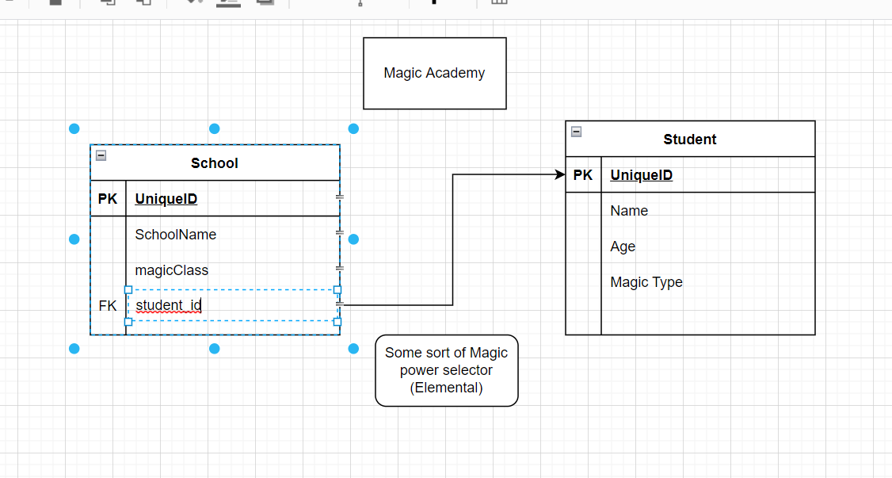
Erd Design
This is why I tried to better understand the structure but didn’t grasp the functionality until I actually created the Front End

Slide 5
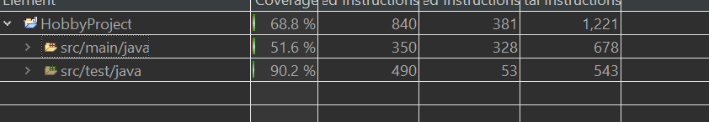
Testing

Slide 6
Sprint Review
What went right?
Completed all CRUD functionality for the Full Stack Application.
Built a fully functioning frontend.
Completed Testing for full application.
What went wrong?.
Testing and Time Management.
Wanted to include more features on the website and focused more on this.
Better More efficient planning with exact functionality
Code to Test to make sure everything is integrated and everything that will be needed is in the code.

Slide 7
Application Run Through

Slide 8
Conclusion
Project MVP was Mostly all met.
Able to create a full stack application with functioning tests.
Leant a lot and will continue to add features and testing in my spare time to improve my understanding of all the technologies I learnt.
Built an understanding on how to take on a Project from ground up.
Built an understanding of best practices throughout the project.

Slide 9
Any questions

